Slide 1


CMR TECHNICAL CAMPUS UGC (Autonomous) Kandlakoya, Medchal Road, Hyd-501 401 Department of Electronics & Communication Engineering Real Time Project Review Car Driving System to Assist Physically Challenge
BATCH NO : 07
Project Guide : ROLL NUMBERS :
Name: S.Aparna 227R1A0587-G.Suraj
Designation :Assistant Professor 227R1A0598-K.Prudvi Raj
Project Coordinator : 227R1A0570-B.Nivedhitha
Name:Mr.G.Pavan Kumar
Designation: Assistant Professor

Slide 2
CONTENTS
Abstarct
Introduction
Literature Survey
Proposed Methodology
Implementation & Architecture
Results & Discussion
Conclusion & Future Scope
Reference

Slide 3
ABSTRACT
This paper presents a car driving system which is controlled according to the gesture movement based on the input signals given to the MEMS accelerometer. According to the movement of the hand(i.e. left, right, up and down), the vehicle move in a forward, backward, left and right direction. The system integrates advanced technologies such as sensors, actuators, and artificial intelligence algorithms to provide a safe and intuitive driving experience for users with varying mobility impairments.

Slide 4
INTRODUCTION
The evolution of automotive technology has brought significant advancements in enhancing the driving experience and ensuring safety. One of the most transformative applications of these innovations is the development of car driving systems specifically designed to assist physically challenged individuals. This groundbreaking initiative aims to empower people with physical disabilities, granting them greater independence and mobility.

Slide 5
LITERATURE SURVEY
S.No. | Name of Author | Title of the paper | International journal/conference | Volume No. | Issue | ISBN/ ISSN | Indexing
1. | Nimal, R.J.G.R., Hussain, J.H. | Effect of deep cryogenic treatment on EN24 steel | International Journal of Pure and Applied Mathematics | 116 | July 27, 2017 | ISSN-2277-9655, Impact factor-4.116 | 1345-1347
2. | Parameswari, D., Khanaa, V. | Deploying lamport clocks and linked lists | International Journal of Pharmacy and Technology | 08 | Dec 25, 2016 | 762-766, doi: 10.1109/TRO.2004.842350. | 787-790
3. | Pavithra, J., Peter, M., Gowtham Aashirwad, K. | A study on business process in IT and systems through extranet | International Journal of Pure and Applied Mathematics | 116 | 05,May-2017 | PP-571-576, 2017

Slide 6
PROPOSED METHODOLOGY
The readings (movement of the hand) are taken from the accelerometer attach on the hand. These readings are sent to Arduino uno.
Through Arduino the readings are encoded by HT12E.
The Encoder sends these readings through RF transmitter to the receiver attached on the car.
These readings are sent to the receiver and are decoded by HT12D.
After the readings are decoded they are send to L298N motor driver due to which the motors are moved.
Thus the movement of car is achieved. There are three hand gestures which can be recognized by the car. They are RIGHT, LEFT, FORNT and BACK.

Slide 7
IMPLEMENTATION & ARCHITECTURE
This system allows them to control a vehicle using hand gestures. Here are the key components and steps involved:
MEMS Accelerometer Sensor:
The system uses a MEMS (Micro-Electro-Mechanical Systems) accelerometer sensor.
This sensor is fixed on the hand of the physically challenged person.
It detects hand movements (left, right, up, and down).
Microcontroller:
A microcontroller (such as an Arduino or Raspberry Pi) processes the accelerometer data.
When the user moves their hand, the microcontroller receives signals from the sensor.
Gesture Recognition:
The microcontroller compares the received gesture data with a stored program.
Based on the recognized gesture (e.g., hand tilt left), it generates corresponding instructions.
Power Supply:
The microcontroller operates at 5V, supplied by a power source.

Slide 8
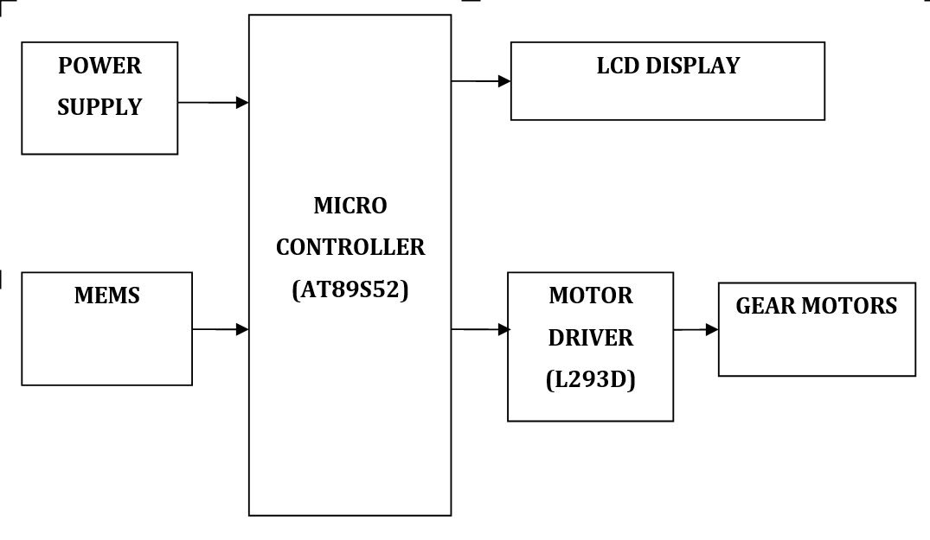

Slide 9
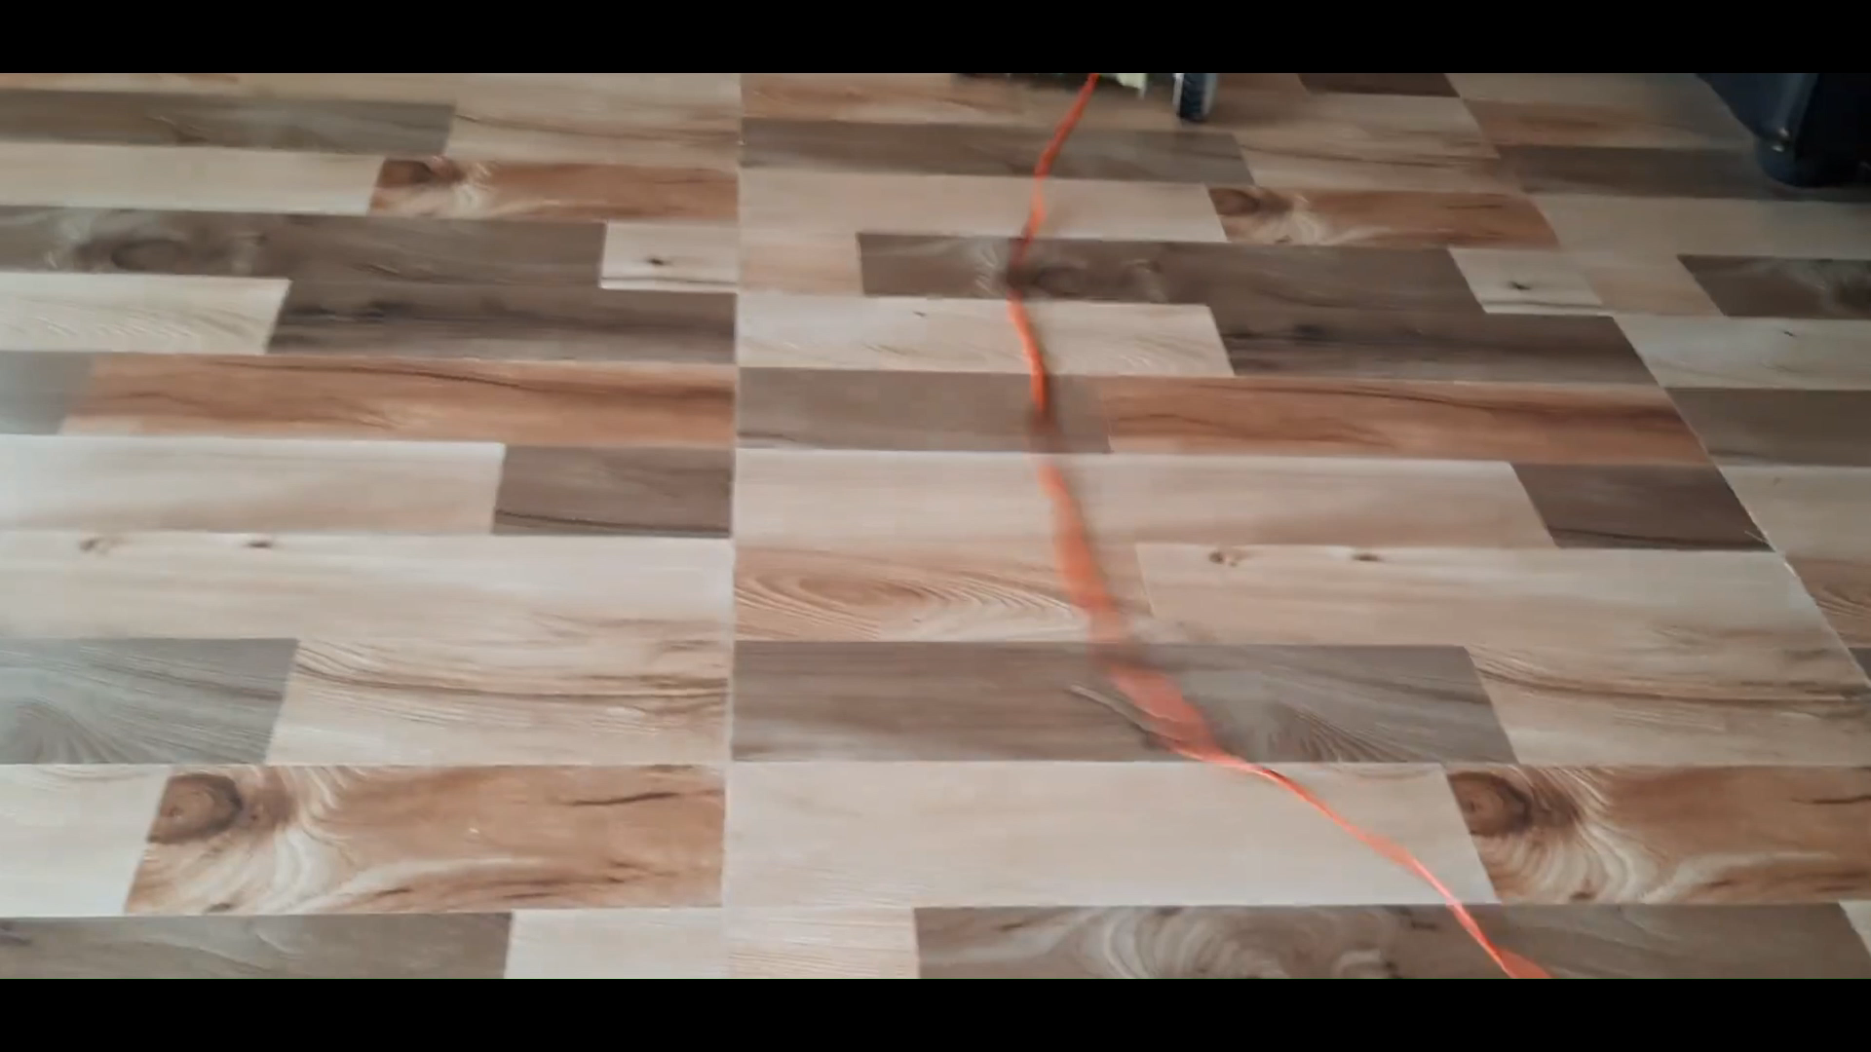
RESULTS

Slide 10
CONCLUSION AND FUTURE SCOPE
This paper describes a gesture recognition car system using MEMS accelerometers for a physically challenged person. A program is implemented in the microcontroller and according to the gesture movement, the gesture code is compared with the stored program. And after that the instruction is sent to the microcontroller of the vehicle unit. Thus the vehicle moves in the respective direction.

Slide 11
REFERENCES
Prashant J. Mahajan; Kalyani V. Pagare, “PIR based automatic fever testing”, International Research Journal of Engineering and Technology(IRJET),vol-07,issue no-04,pp.1345-1347,2020.
Pooja Ajmera, “INFRARED SENSOR” , International Research Journal of Engineering and Technology(IRJET), ISSN: 2278-0181 vol-05,issue no-23,1559-1557.
Hanzhong, “DESIGN OFA NON-CONTACT INFRARED THERMOMETER”, International Research Journal of Engineering and Technology(IRJET),ISSN: 2581-0181 vol-08,issue no-13,1859-183
Rohit Ramagade , Uday Thak, Harshad pidurkar, Lokesh Kathale; ”INNOVATIVE TECHNOLOGIES FOR TEMPERATURE MEASUREMENT OF AERO ENGINE COMPONENT”, International Research Journal of Engineering and Technology(IRJET), ISSN: 2395-0056 vol-05,issue no-23, 2395-0072
Akshay Sharma A S, “ Review on Automatic Sanitizer Dispensing Machine”, International Research Journal of Engineering and Technology(IRJET),vol-09,issue no-07,pp.725-726,2020.

Slide 12
Q&A

Slide 13
THANK YOU

